Slide 1
FoodShed: Medium-Fi Prototype
Nathan Tindall, Shalom Rottman-Yang, Vincent Becerra, Raymond Lin

Slide 2
Overview/Recap
Function
Goal
This Week.. InVision Refine tasks Enhanced UI

Slide 3
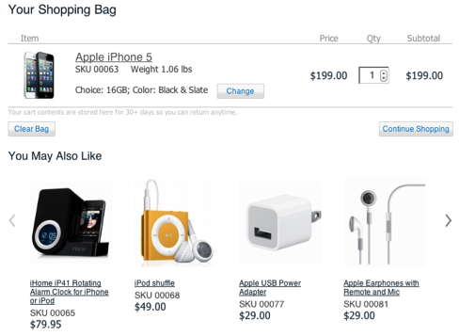
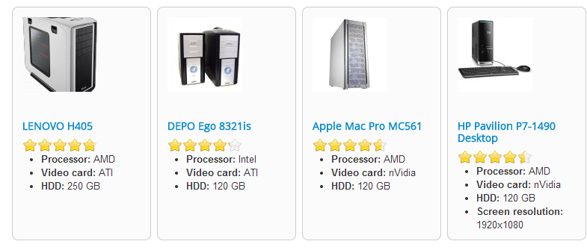
Task 1
Finding and storing a product
New: related items
New: Score Breakdown

Slide 4
Task 2
Mark items for later reference
Inventory
Comparison

Slide 5
Task 3
Comment
Review
Rate

Slide 6
Revised UI Design

Slide 7
Scenario 1

Slide 8
Scenario 2

Slide 9
Scenario 3

Slide 10
Tools Used
InVision
Worked: tasks simulations, UI design, comparisons, inventory
Needs Improvement: Integrate related items
Limit: No actual data

Slide 11
In Closing
Pros: more refined UI, functionalities, inventory/comparison, sticky menu bar
Cons: No actual data, related items

